Slide 1

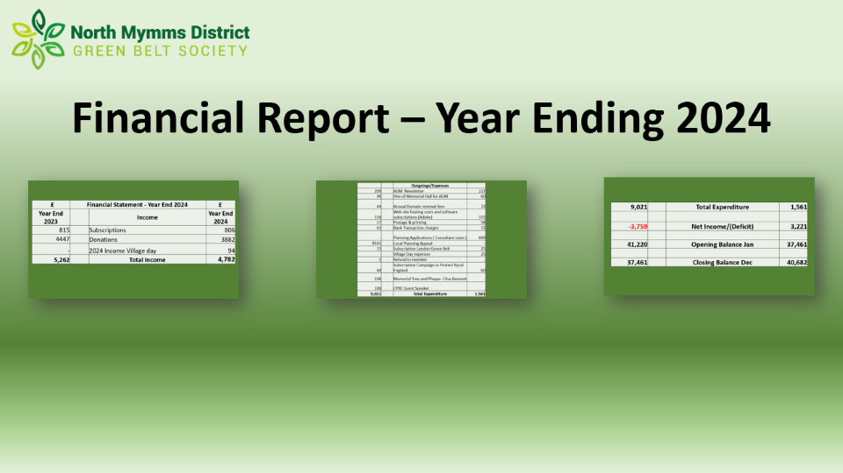
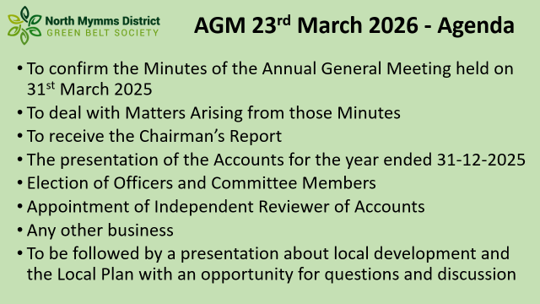
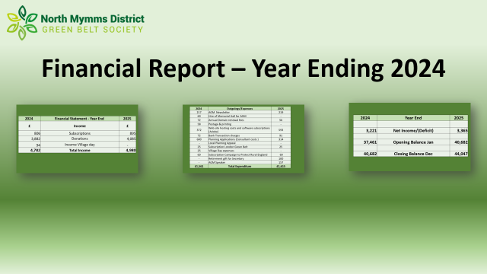
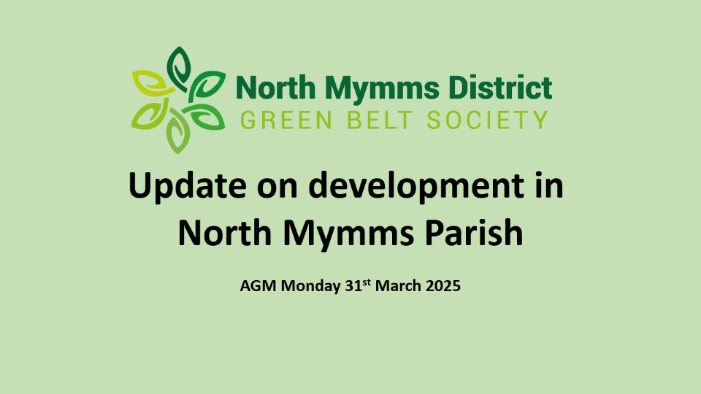
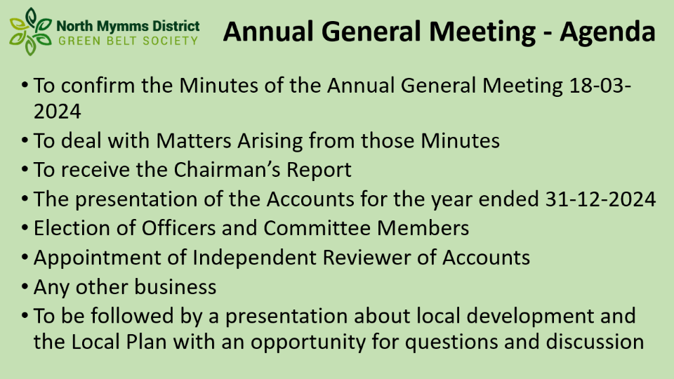



Slide 2

AGM 23rd March 2026 - Agenda
  To confirm the Minutes of the Annual General Meeting held on 31st March 2025
  To deal with Matters Arising from those Minutes
  To receive the Chairman’s Report
  The presentation of the Accounts for the year ended 31-12-2025
  Election of Officers and Committee Members
  Appointment of Independent Reviewer of Accounts
  Any other business
  To be followed by a presentation about local development and the Local Plan with an opportunity for questions and discussion

Slide 3
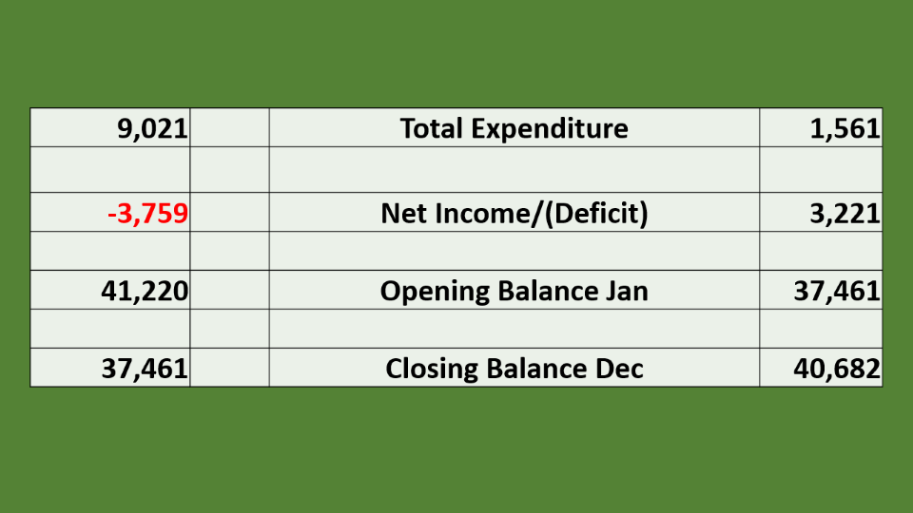
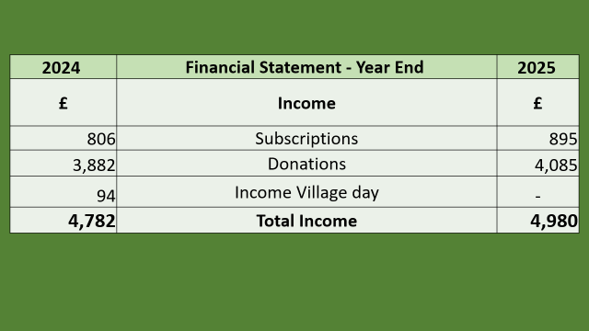
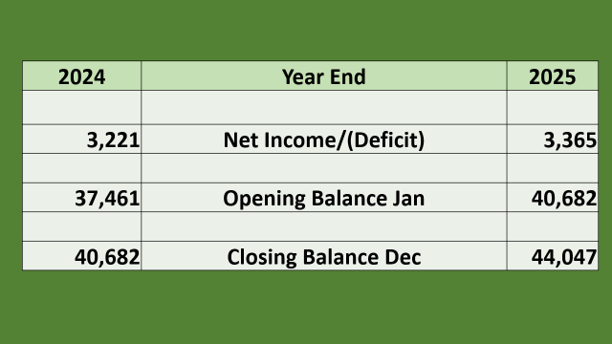
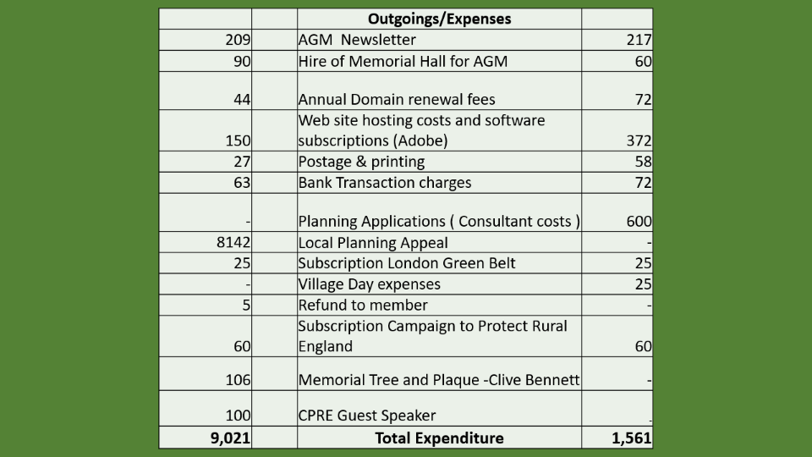
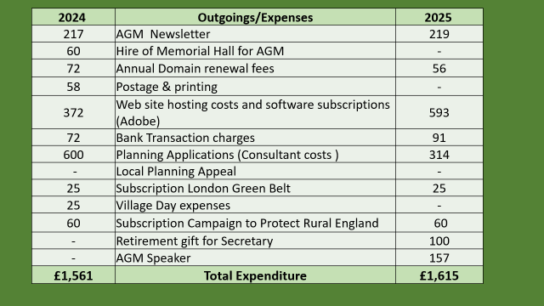
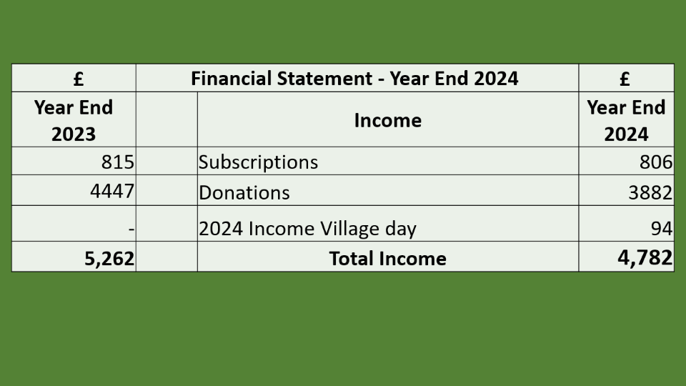
Financial Report – Year Ending 2024

Slide 4
2024 | Financial Statement - Year End | 2025
£ | Income | £
806 | Subscriptions | 895
3,882 | Donations | 4,085
94 | Income Village day | -
4,782 | Total Income | 4,980

Slide 5
2024 | Outgoings/Expenses | 2025
217 | AGM Newsletter | 219
60 | Hire of Memorial Hall for AGM | -
72 | Annual Domain renewal fees | 56
58 | Postage & printing | -
372 | Web site hosting costs and software subscriptions (Adobe) | 593
72 | Bank Transaction charges | 91
600 | Planning Applications (Consultant costs ) | 314
- | Local Planning Appeal | -
25 | Subscription London Green Belt | 25
25 | Village Day expenses | -
60 | Subscription Campaign to Protect Rural England | 60
- | Retirement gift for Secretary | 100
- | AGM Speaker | 157
£1,561 | Total Expenditure | £1,615

Slide 6
2024 | Year End | 2025
3,221 | Net Income/(Deficit) | 3,365
37,461 | Opening Balance Jan | 40,682
40,682 | Closing Balance Dec | 44,047

Slide 8
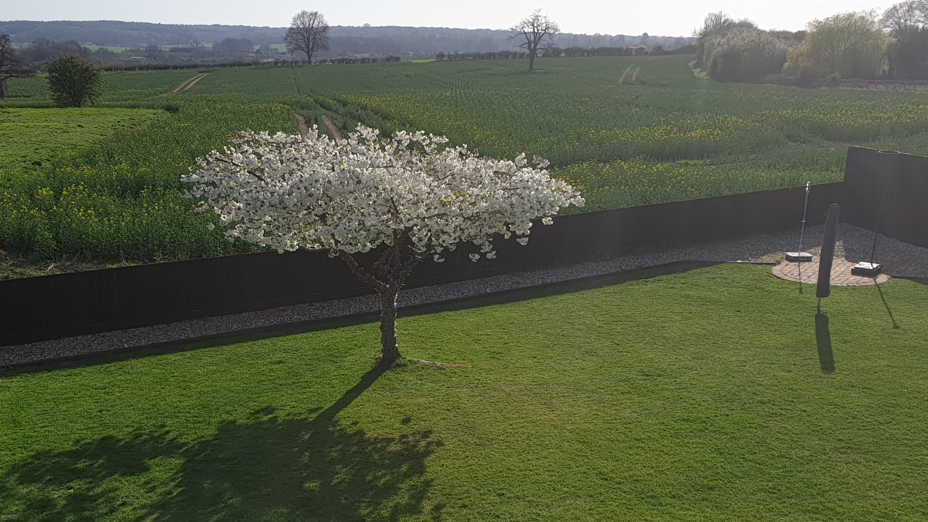

Slide 9
Update on Development in
North Mymms Parish
AGM Monday 23rd March 2026

Slide 10
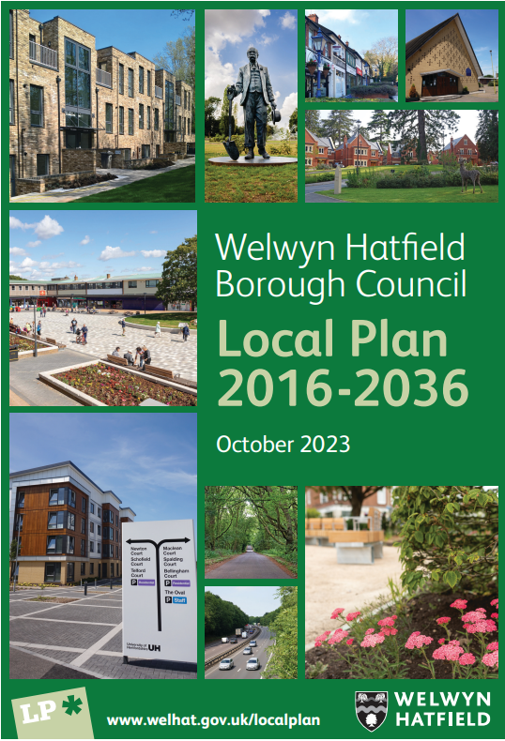
Welwyn Hatfield Local Plan
Plan began in 2009:
  took 14 years
Adopted by Council
  in Oct 2023
Shortfall in housing so required
new plan to be submitted by
October 2026
New plan out for consultation

Slide 11
Local Plan Review – public consultation
Plan needs to address shortfall and plan for 840 homes per annum
Allow for 10% population increase 2024-2043
The plan needs to identify sites for 16,000 new dwellings
Existing permissions and allocations provide for 10,000
This plan has to decide where remaining 6,000 go by October 2026

Slide 12
Existing allocations:
Ref | Site name | Dwellings
SDS 7 | Marshmoor Welham Green | 100
HS 44/45 | Land south of Welham Manor and west of station road | 72
HS 46 | Dixons Hill Road, Welham Green | 120
HS 21 | Land west of Golf Club Road, Brookmans Park | 14
HS 23 | Land east of Golf Club Road, Brookmans Park | 10
HS 22 | Land west of Brookmans Park station. | 428
HS 25 | Land north of Hawkshead Road, Little Heath | 34
HS 47 | Part of Studlands/Videne, Little Heath | 61
Total |  | 839

Slide 13
New potential site allocations being considered
(All Green Belt Sites):
Ref | Site name | Dwellings
HEL 38 | Brookmans Park- Land North of Bradmore Way | 140
HEL 86 | Brookmans Park- Potterells Farm | 80
HEL 89 | Brookmans Park- Potterells Farm | 150
HEL 7 | Little Heath- Swanley Bar | 90
HEL 1 | Welham Green- Barnbeth 24 Station Road | 7
HEL 4 | Welham Green- Land South of Bulls Lane | 60
HEL 66 | Welham Green- Land North of Pooleys Lane | 80
HEL 5 | Little Heath- Leggatts Park | 465
Total |  | 1072

Slide 14
Schedule of reasonable alternative sites
(not included at this time):
Ref | Site name | Dwellings
HEL 48 | Brookmans Park- Land West of Bluebridge Road | 155
HEL 60 | Brookmans Park- Land at Raybrook Farm | 28
HEL 37 | Bell Bar- Upper Bell Lane Farm- Bell Lane | 100
HEL 39 | Bell Bar- Land to the Northeast- Great North Road | 34
HEL 80 | Bell Bar- Home Farm Buildings | 8
HEL 15 | Bullens Green- Tollgate Farm. | 63
HEL 28 | Bullens Green- Tollgate Farm. | 180
HEL 49 | Little Heath- Land South of Hawkshead Road | 88
HEL 88 | Brookmans Park- Transmitter station (employment) | 0
HEL 31 | Hatfield- New Barnfield (employment) | 0
Total |  | 656

Slide 15
New dwellings to be spread over five tiers:
WGC & Hatfield
Brookmans Park, Welham Green, Cuffley, Welwyn and Little Heath
Small Villages
Green Belt villages
Green Belt rural areas

Slide 16
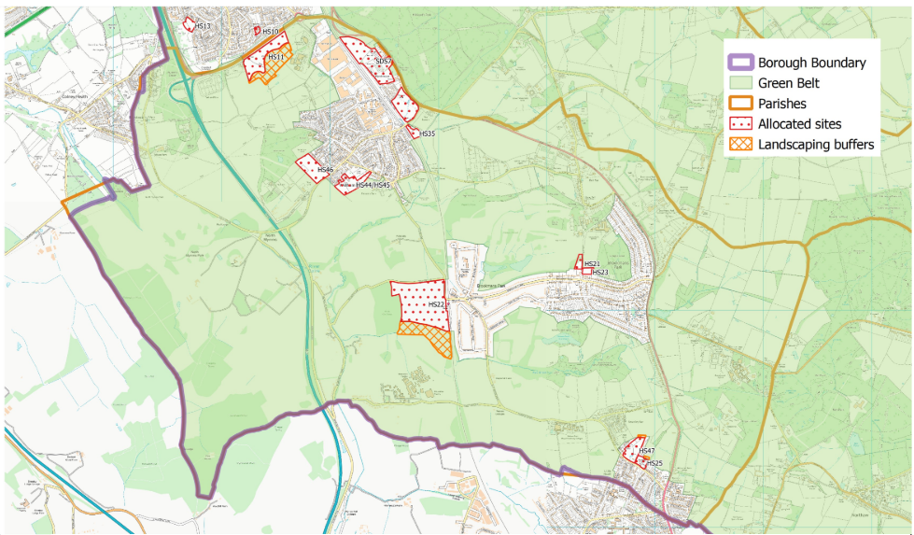

Slide 17
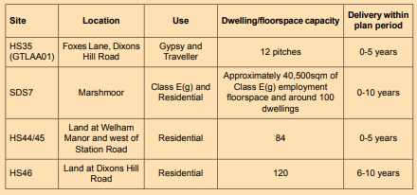

Welham Green
Land at Southway (HS11): 120 dwellings + 2FE Primary school

Slide 18
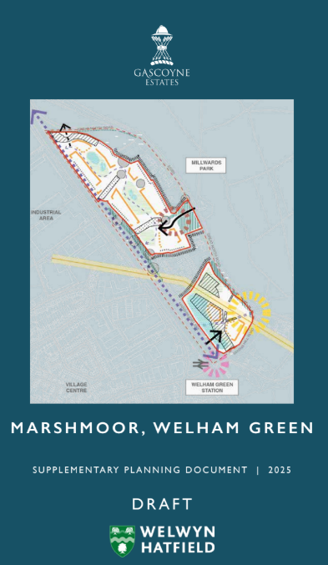
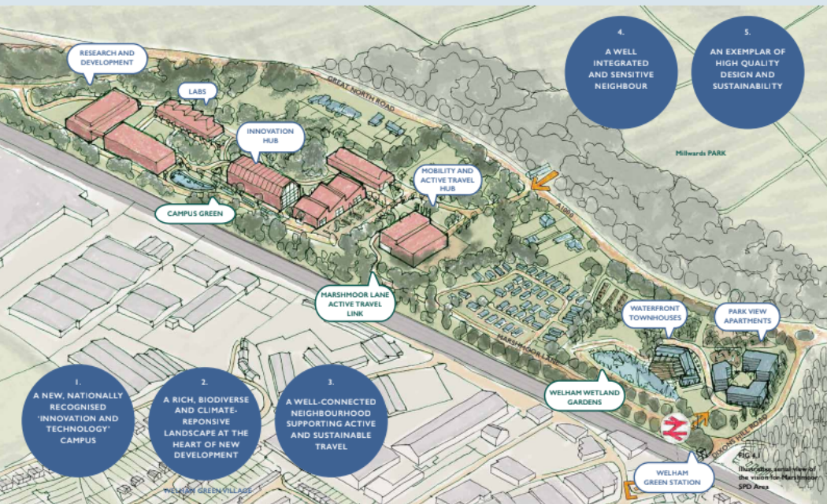
Welham Green – SDS7 Marshmoor
Consultation on the scheme has taken place prior to planning application

Slide 19
Welham Green – SDS7 Marshmoor
Developer has carried out pre-application consultation (completed 21.03.25)
The site is within the local plan – you can no longer object to the principle of the development
NMDGB have raised concerns about the proposed access off Dixons Hill Road into Marshmoor Lane
HCC Highways department need to take an overall view of the impact of all the local developments on the traffic on Dixons Hill Road.

Slide 20
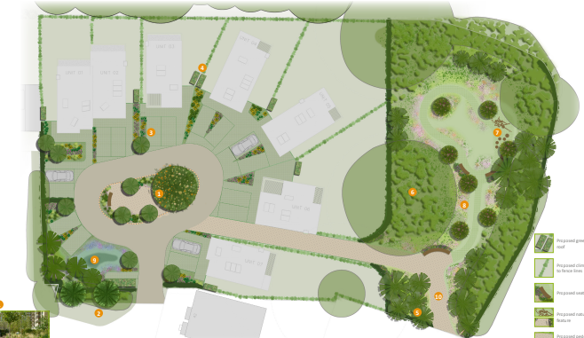
Welham Green – HS44 Welham Manor
Planning
Permission
granted for
7 dwellings
Part of 84
in plan for
HS44/45

Slide 21
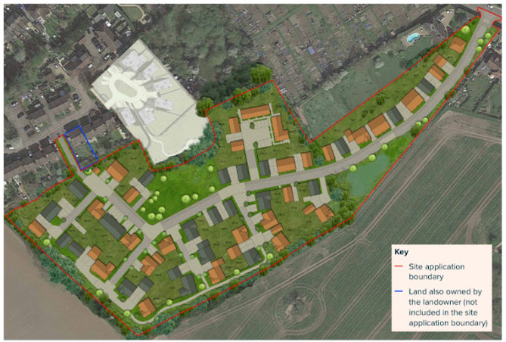
Welham Green – HS45 Land west of Station Road
Developer had public consultation in February 2025 prior to planning application

Slide 22
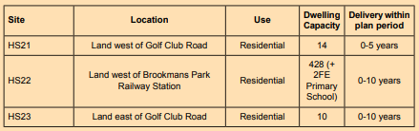
Brookmans Park

Slide 23
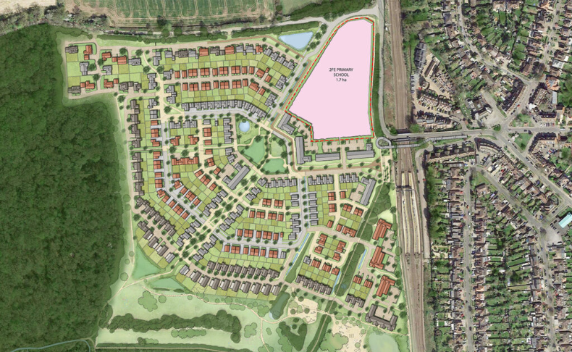
Brookmans Park – HS22 West of BP
Developer has carried out public consultation prior to making planning application
273 Houses
148 Apartments

Slide 24
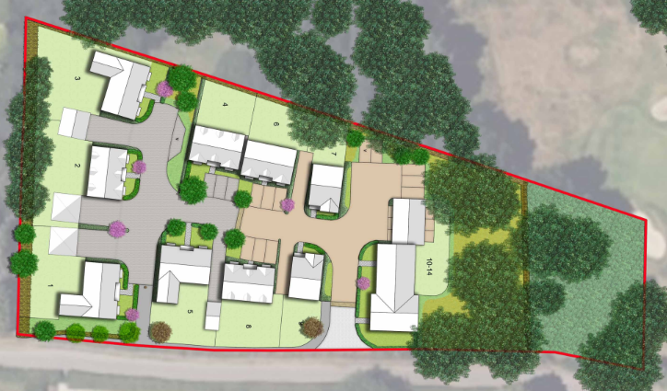
Brookmans Park – HS47 Golf Club Road
Planning permission granted for 14 dwellings

Slide 25

Little Heath

Slide 26
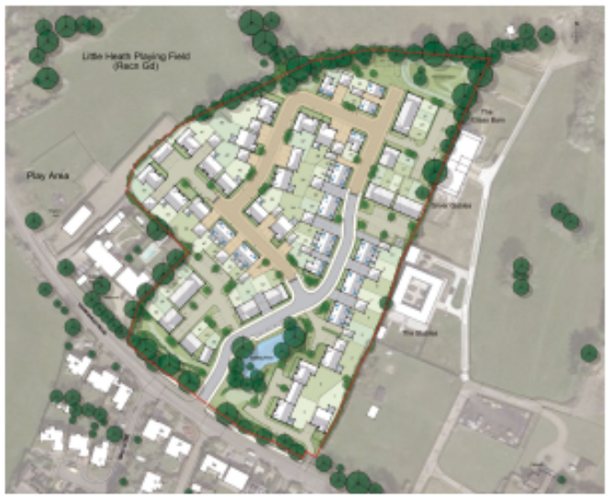
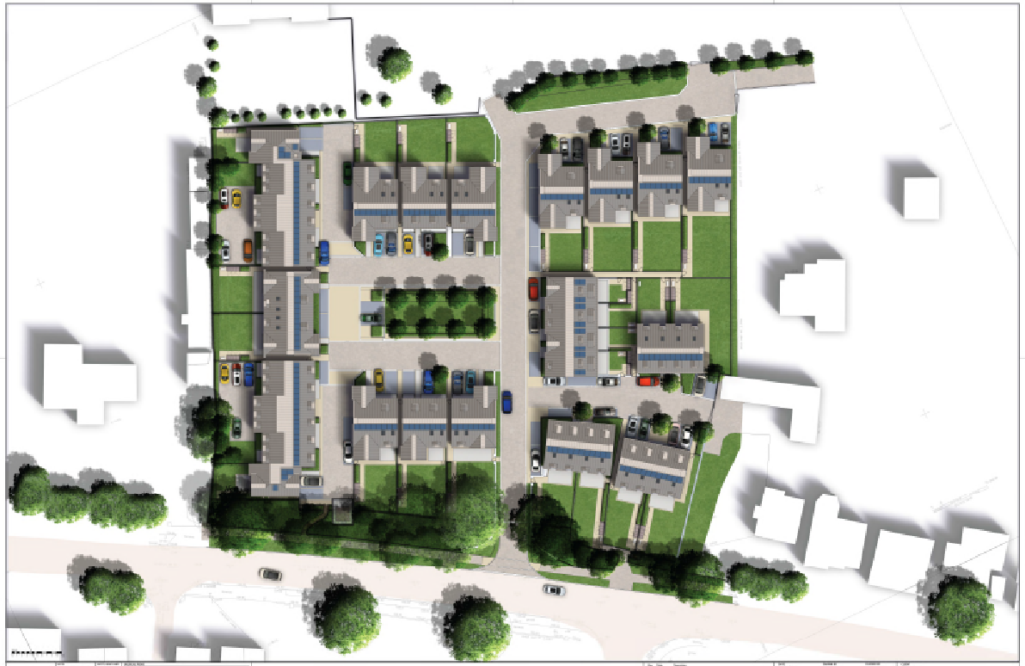
Little Heath
HS47 Hawkshead Road
HS25 Hawkshead Road
Under construction
Under construction

Slide 27
North Mymms Parish:
Brookmans Park, Welham Green & Little Heath
Adopted Local Plan includes: 1,135 homes
Extra new plan allocations: 1,072 homes
Total to be built in North Mymms: 2,307

Slide 28
Non-Local-Plan Development
Bullens Green (Partly in St. Albans):
  144 dwellings. Under construction
Hope and Anchor (Dixons Hill Road):
  9 dwellings. Under construction
Bell Bar/Bell Lane (several sites, granted):
  7+ dwellings
Glendee Kennels (decision pending):
  9 dwellings

Slide 29
New Local Plan Timelines
Early engagement (Sept 2024 to Nov 2024) - completed
Reg 18 Consultation (plan preparation) - Summer 2026
Evidence gathering (Call for Sites) - 2024-2026
Reg 19 & 20 Publication and Representations - Spring 2026
Reg 22 Submission to Secretary of State - October 2026
Independent examination - Nov 2026 - April 2027
Adoption - June 2027

Slide 30
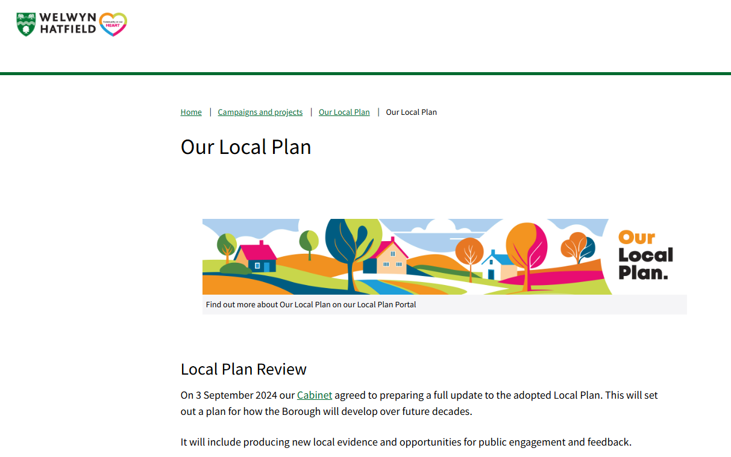
Our Local Plan – Welwyn Hatfield Borough Council https://www.welhat.gov.uk/ourlocalplan

Slide 31
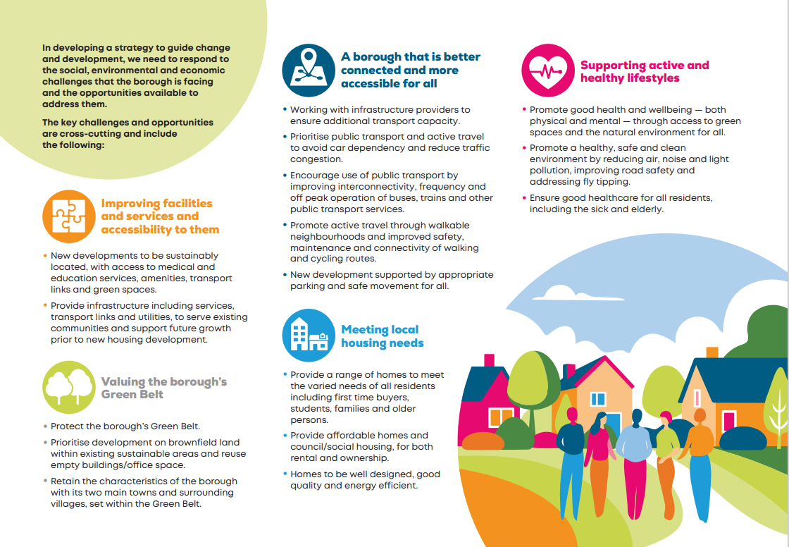
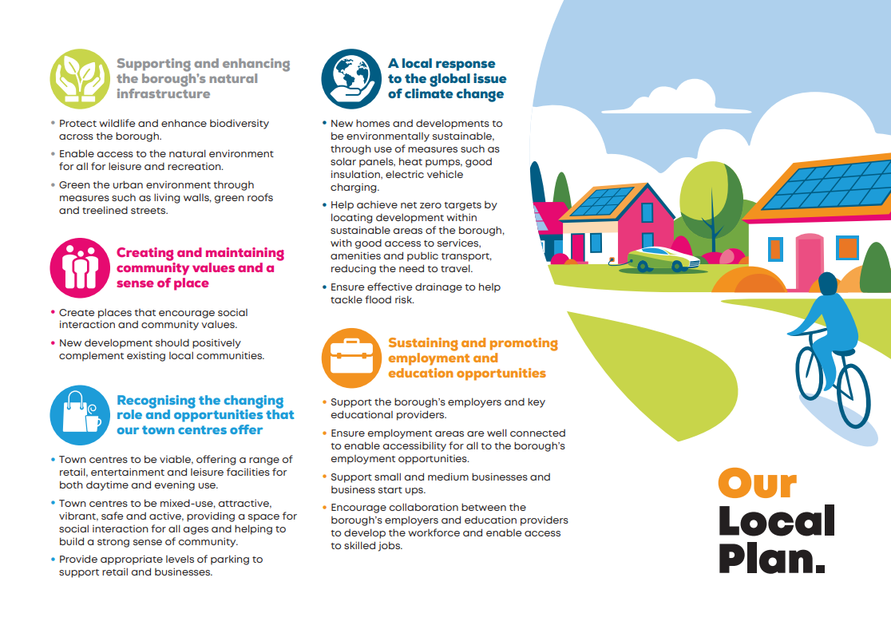
Early engagement – Key themes
Early Engagement Key Themes - Our Local Plan

Slide 32
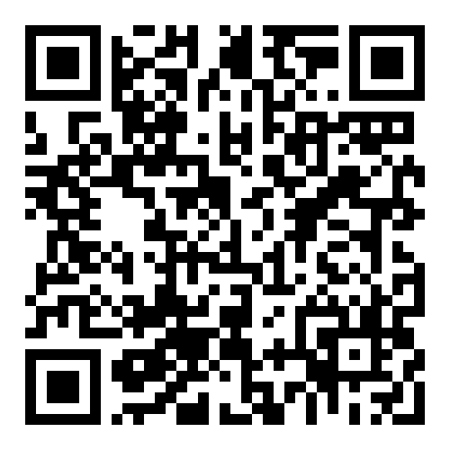
Questions?

